Slide 1
Chapter 7
Customer-Driven Marketing Strategy
Creating Value for Target Customers

Slide 2
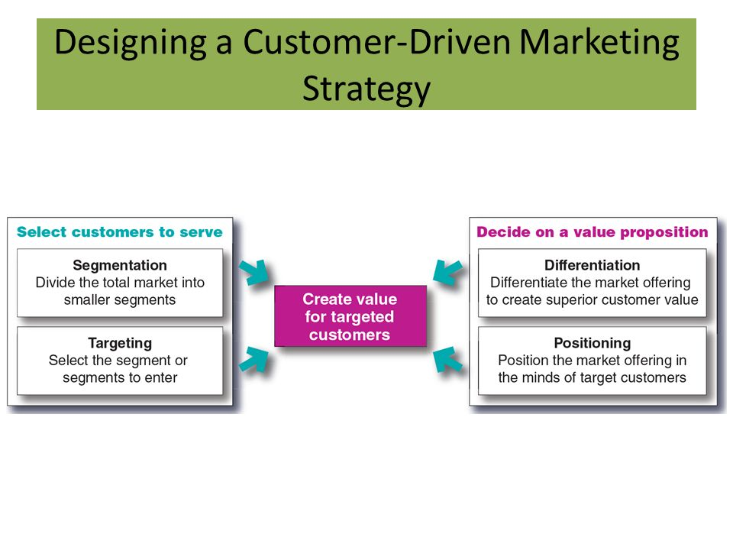


Slide 3
Market Segmentation
Market segmentation is the process that companies use to divide large, heterogeneous markets into small markets that can be reached more efficiently and effectively with products and services that match their unique needs

Slide 4
Market Segmentation
Segmenting consumer markets
Segmenting business markets
Segmenting international markets
Requirements for effective segmentation

Slide 5
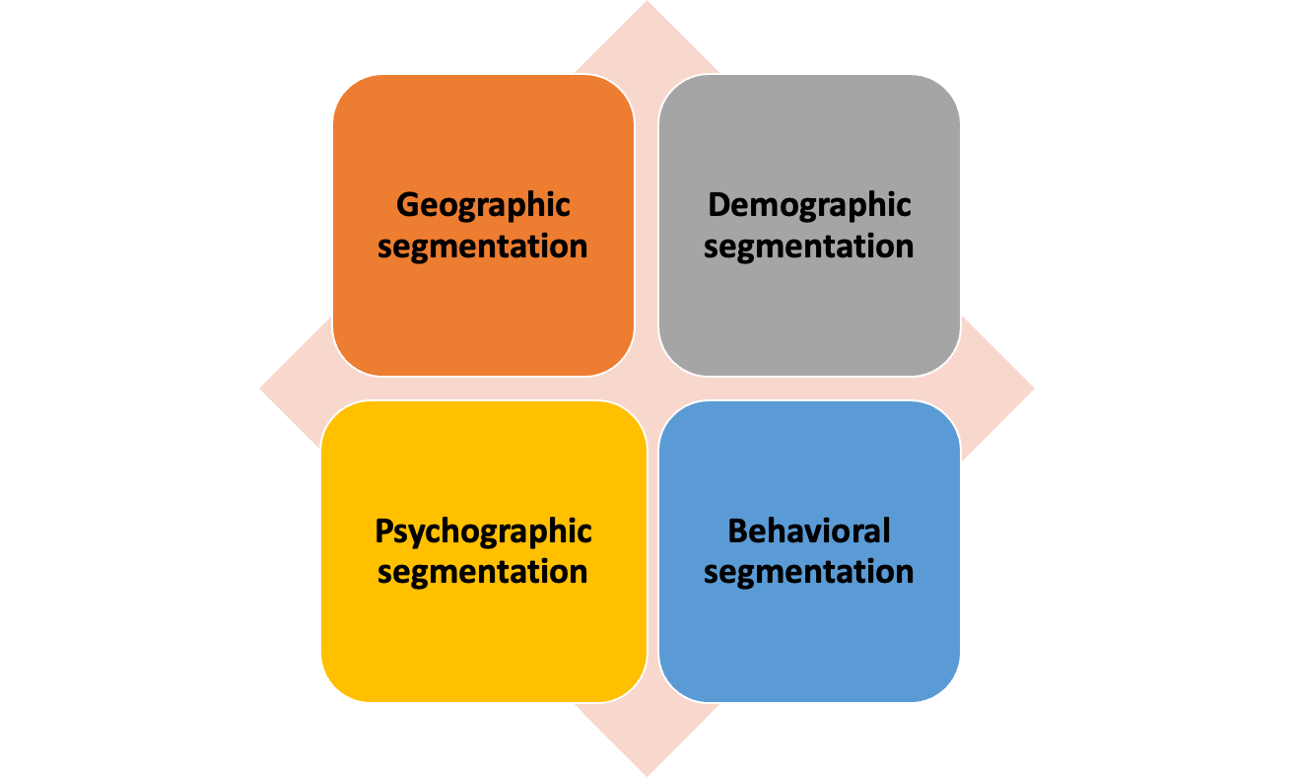
Segmenting Consumer Markets

Slide 6
Segmenting Consumer Markets
Geographic segmentation divides the market into different geographical units such as nations, regions, states, countries, or cities.
Demographic segmentation divides the market into groups based on variables such as age, gender, family size, family life cycle, income, occupation, education, religion, race, generation, and nationality
Psychographic segmentation divides buyers into different groups based on social class, lifestyle, or personality traits

Slide 7
Segmenting Consumer Markets
Behavioral segmentation divides buyers into groups based on their knowledge, attitudes, uses, or responses to a product
Occasions (dates in Ramzan)
Benefits sought (Some people buy cosmetic products to remove wrinkles while others buy products to reduce acne).
User status (EX-users, potential Users, First time Users and regular users)
Usage rate (heavy, medium, and light users and non users)
Loyalty status (According to their loyalty status)

Slide 8
Business Markets segmentation
Geographically
Demographically (Industry, company size)
Customer operating characteristics (technology)
Purchasing approaches (centralized or decentralized, purchasing criteria)
Situational factors (Urgency, specific application, size or order)
Personal factors (Buyer-seller similarity, attitude towards risk, loyalty)

Slide 9
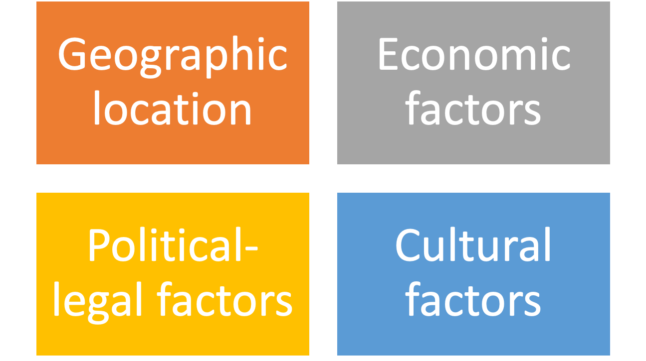
Segmenting International markets

Slide 10
Segmenting International markets
Intermarket segmentation divides consumers into groups with similar needs and buying behaviors even though they are located in different countries

Slide 11
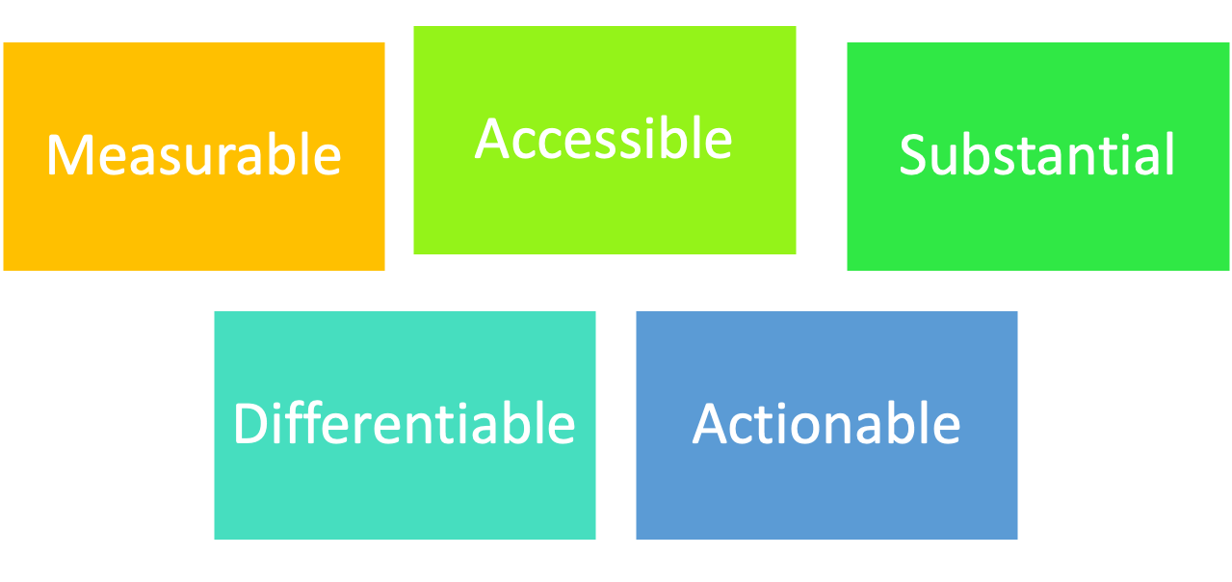
Requirements for Effective Segmentation
To be useful, market segments must be:

Slide 12
Evaluating Market Segments
.
Segment size and growth
largest and fast growing segments are not always attractive
Segment structural attractiveness
less attractive, if it have too many competitors
Company objectives and resources
company skills

Slide 13
Target Marketing Strategies
1. Undifferentiated marketing targets the whole market with one offer
  Mass marketing
  Focuses on common needs rather than what’s different
2. Differentiated marketing targets several different market segments and designs separate offers for each
Goal is to achieve higher sales and stronger position
3. Concentrated marketing targets a small share of a large market such as Niche segment
4. Micromarketing is the practice of tailoring products and marketing programs to suit the tastes of specific individuals and locations
  Local marketing (Cities and Stores) and Individual marketing (individual customers)

Slide 14
Choosing a Targeting Strategy
Depends on:
Company resources
(Limited resources-concentrated marketing strategy)
Product variability
(Undifferentiated marketing for uniform products)
Product life-cycle stage
  (introduction stage-Undifferentiated, mature stage-differentiated)
Market variability
(Undifferentiated marketing)
Competitor’s marketing strategies
(Differentiated strategy-Differentiated, Undifferentiated-Differentiated )

Slide 15
Socially Responsible Target Marketing
Benefits customers with specific needs
Concern for vulnerable segments
Children
  Alcohol
  Cigarettes
  Internet abuses

Slide 16
Differentiation and Positioning
Product position is the way the product is defined by consumers on important attributes—the place the product occupies in consumers’ minds relative to competing products
  Perceptions
  Impressions
  Feelings

Slide 17
Differentiation and Positioning
Positioning show consumer perceptions of their brands versus competing products on important buying dimensions

Slide 18
Differentiation and Positioning
Choosing a Differentiation and Positioning Strategy
Identifying a set of possible competitive advantages to build a position
Choosing the right competitive advantages
Selecting an overall positioning strategy
Developing a positioning statement

Slide 19
Differentiation and Positioning
Identifying Possible Value Differences and Competitive Advantages
Competitive advantage is an advantage over competitors gained by offering consumers greater value, either through lower prices or by providing more benefits that justify higher prices

Slide 20
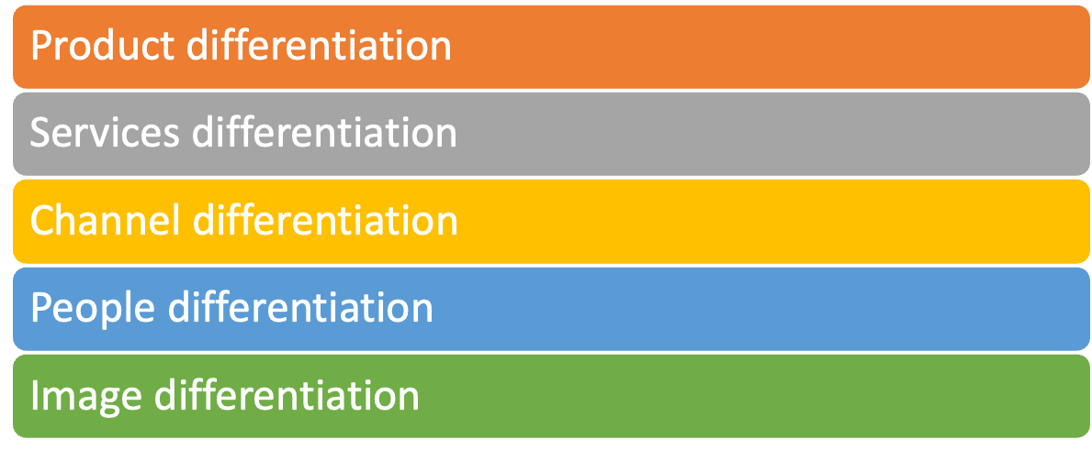
Differentiation and Positioning
Choosing a Differentiation and Positioning Strategy
Identifying a set of possible competitive advantages to build a position by providing superior value from:

Slide 21
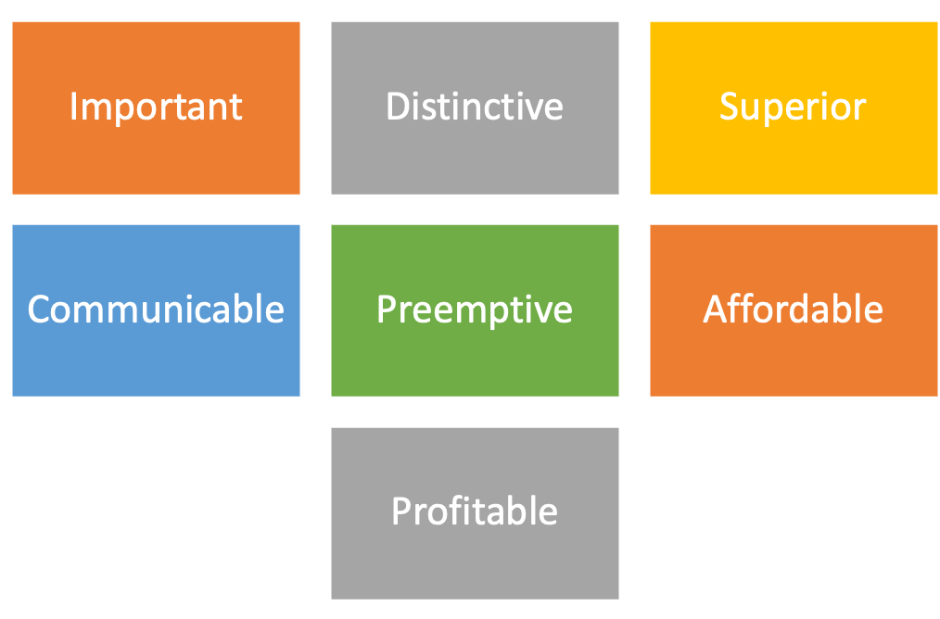
Differentiation and Positioning
Choosing the Right Competitive Advantage
Difference to promote should be:

Slide 22
Differentiation and Positioning
Selecting an Overall Positioning Strategy
Value proposition is the full mix of benefits upon which a brand is positioned
  More for more (Upscale products with high prices)
  More for the same (Upscale products with lower prices)
  The same for less (Good quality products with discounted rates)
  Less for much less (Low quality requirements at lowest prices)
  More for less (Give more benefits at lowest price)

Slide 23
Differentiation and Positioning
Developing a Positioning Statement
To (target segment and need) our (brand) is (concept) that (point of difference)
Choosing the positioning is often easier than implementing the position.
“To busy, mobile professionals who need to always be in the loop, Black Berry is a wireless connectivity solution that gives you an easier, more reliable way to stay connected to data, people and resources while on the go”

